Slide 1
PowerLine E 8 QT (AC)
Air-cooled 7 W UV Laser Marker for high-end marking applications

Slide 2
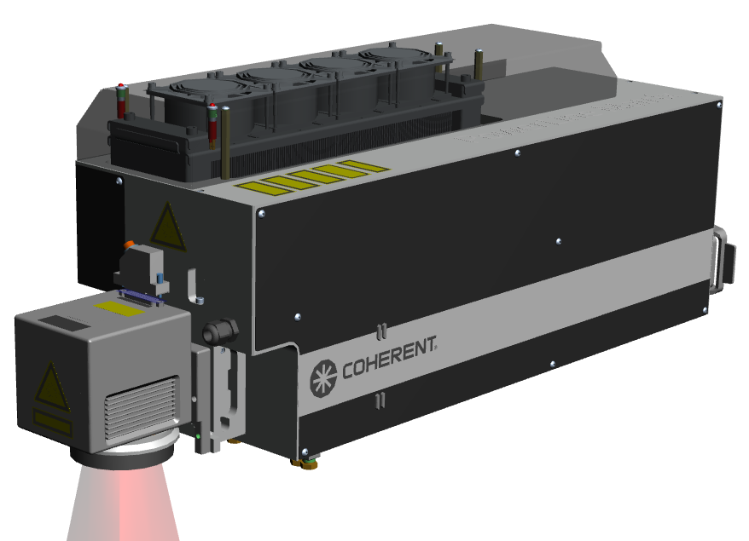
PowerLine E 8 QT (AC) – At a Glance
Integrated laser rail (class 4) with Matrix 8-355-50 laser source
For integration into Coherent Munich or 3rd party handling systems
Compact design with many standard features:
180° beam deflection unit
Positioning laser
Mechanical safety shutter
Internal power sensor
Air recirculation and filtering inside critical optical components
High-end galvanometer scanners and optics
Supply unit (based on Coherent Munich’s PowerLine E - ITX)
Fully air-cooled
VLM / Laser Console software (w/ Matrix 8-355-50 GUI function)
Supports Marking on the Fly, 3D freeform marking etc.
 | PowerLine E 8 QT (AC)
Wavelength | 355 nm
Average Power [@flange] | 7 W (45 kHz)
Average Power [@work piece] | > 6 W (45 kHz)
Frequency Range | 20 - 135 kHz
Pulse Energy | 120 µJ (45 kHz)
Pulse Width | < 25 ns
M² | < 1.2
Controller | RCU – ITX
Software | VLM 5.3 / Windows 10 IoT Enterprise
Chiller | Air cooling
Dimensions (W x H x L) | 225 x 336 x 819 mm

Slide 3
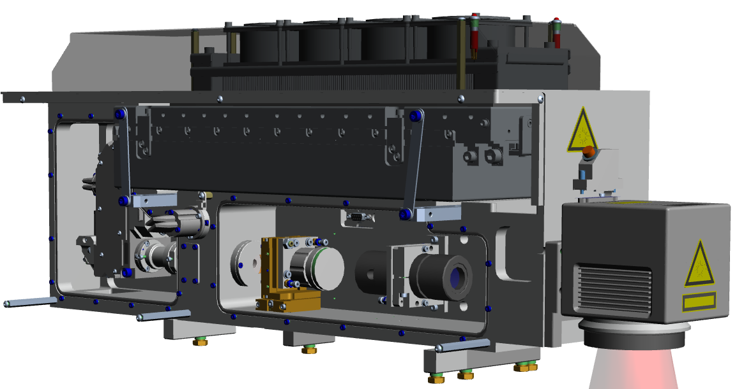
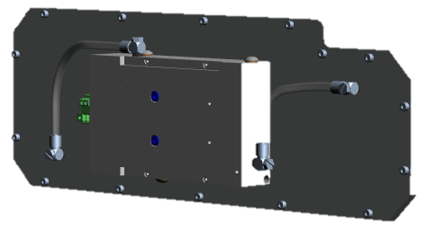
Integration Concept
Power Senor
(air cooled)
Beam Deflection Unit
(incl. safety shutter)
Matrix 8-355-50 Laser Source
Positioning Laser
Scanner
Attenuator (optional)
Purification Unit
Collimation Lens
Beam Expander
FFM (optional)

Slide 4
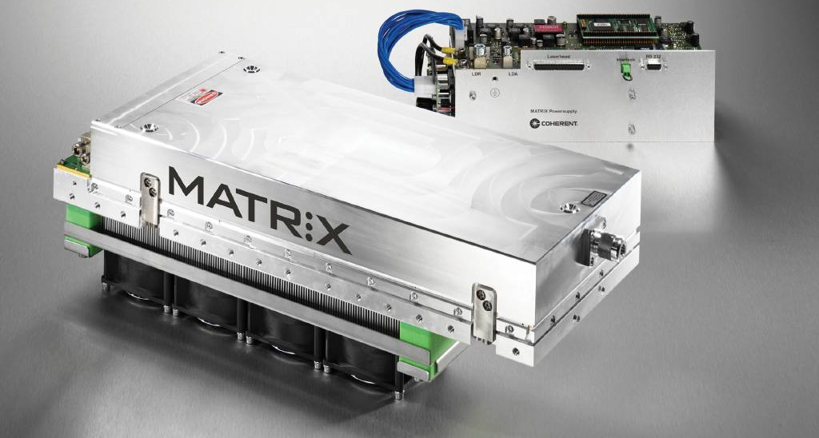
Coherent Matrix 8-355-50 DPSS UV Laser
30 years of UV manufacturing expertise
Extremely robust industrial design
Head assembly in cleanroom, tight quality control
Installed base > 2,000 worldwide
Warranty return-rate < 3%
Sealed UV compartment with purge

Slide 5
Typical Power Curve of the PL E 8 QT
First pulse suppression by applying Pulse EQ Mode
Max. output power at 45 kHz: 7 W [@ flange]
Max. output power at 45 kHz: > 6 W [@ marking field]
Output power is adjusted by adjusting resonator charging time.

Slide 6
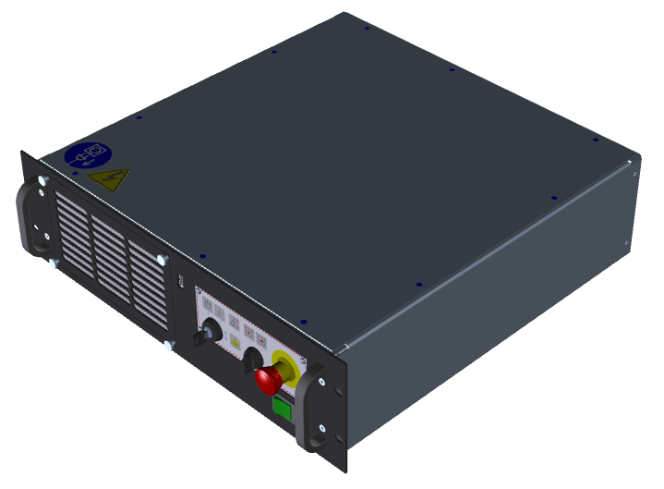
All-in-One Supply Unit
Compact 19-inch rack unit, height: 2 RU
Power supply
ITX CPU motherboard (VLM + VMC)
ALI *) board (scanner / laser control board)
Laser controller
Monitoring of laser marker status
Output power
Frequency
Pilot on/off
Shutter open / close
Error diagnostics
*) Active Laser Interface

Slide 7
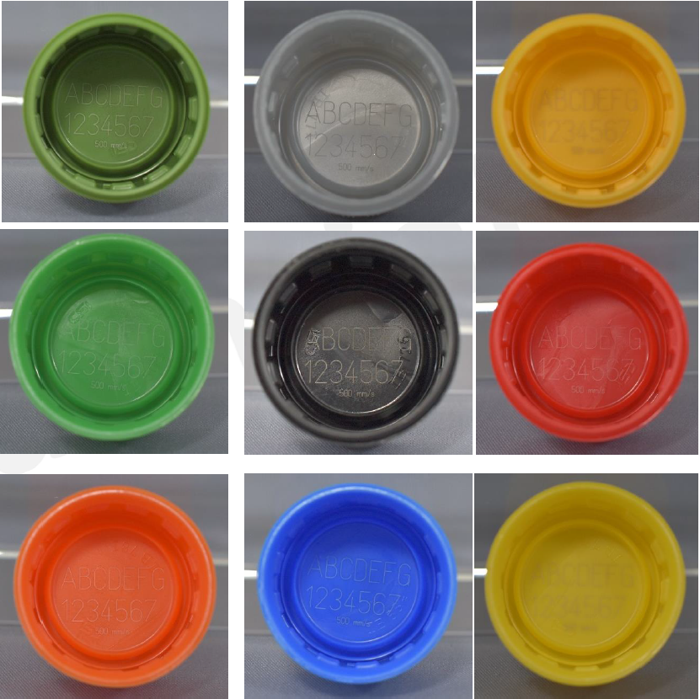
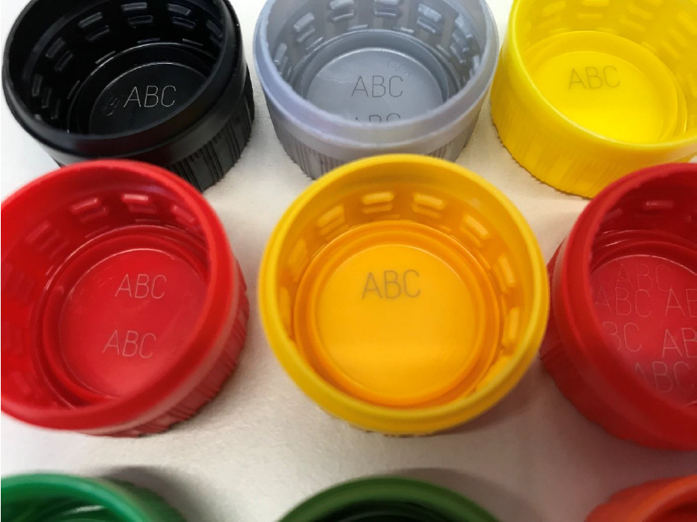
Application Examples
1.2x Beam expander
0.8x Beam expander
Plastic screw caps
Power: 6.5 W
Scan speed 1,900 mm/s
> 25 caps / s

Slide 8
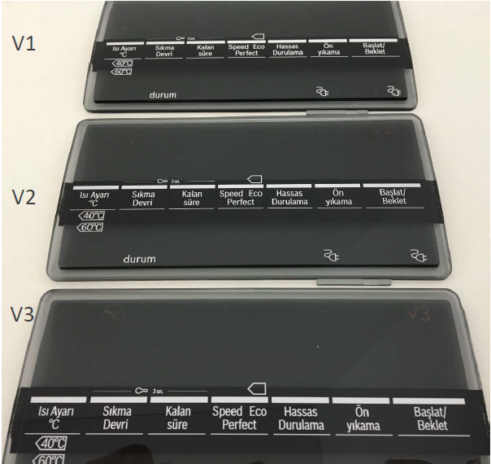
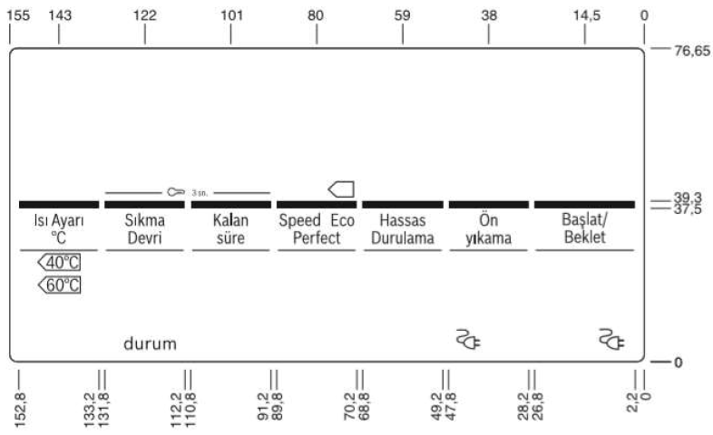
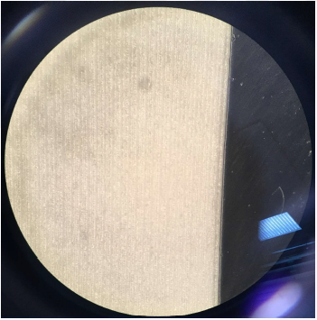
Marking of Home Applicances
Plastic screw caps
Power: 6.5 W
Scan speed 1,000 mm/s
> 25 caps / s

Slide 9
Highlights of the PowerLine E 8 QT (AC)
Compact design by using beam deflection unit folding the laser beam.
Standard features integrated into laser head:
Mechanical shutter for safe laser operation
Power sensor for monitoring / controling laser output power
Laser positioning help for localizing the exact marking area
Beam expander
Fully air-cooled laser marker
Collimated laser beam for easy process setup. Working distance does not depend on beam expansion factor.
Compartments inside laser head for additional optical components
Purification unit circulates and filters air within critical components to avoid undesired opto-chemical reactions.
VLM / VMC software package known from PowerLine E laser markers is included.

Slide 10
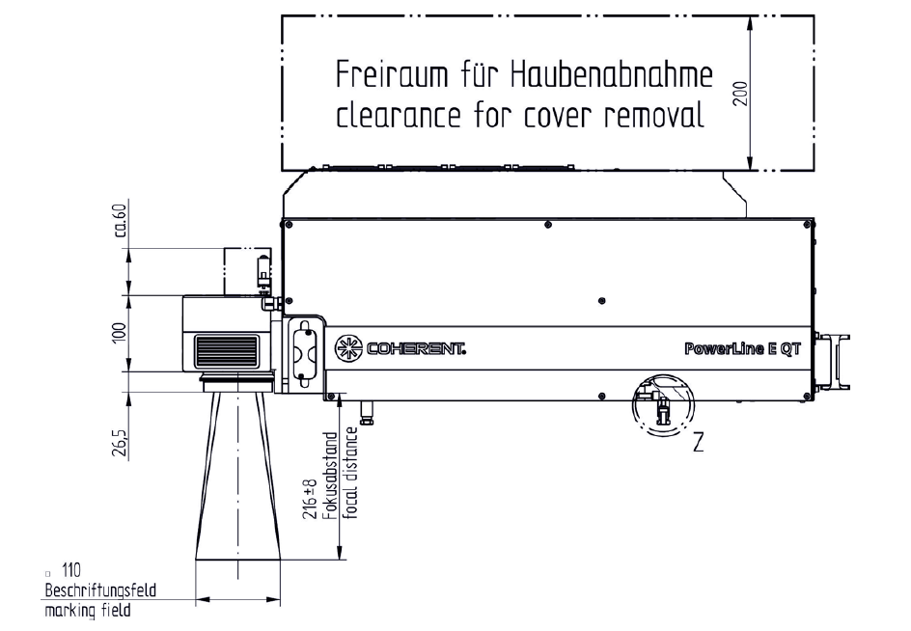
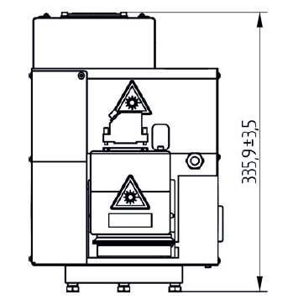
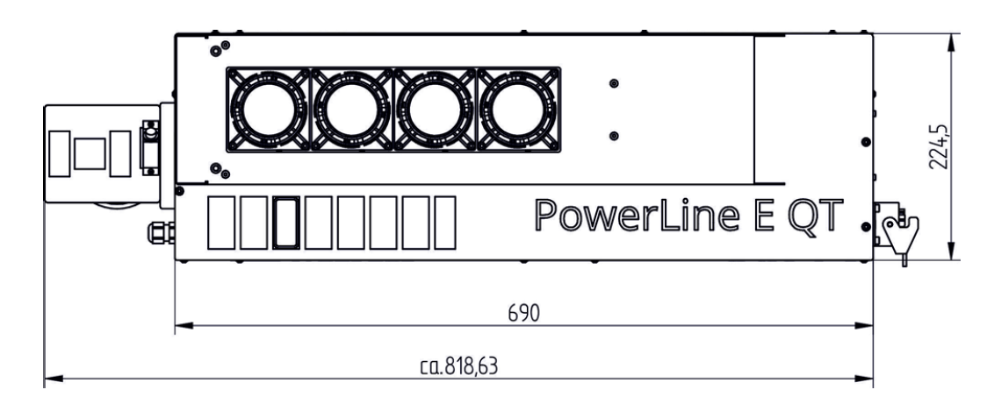
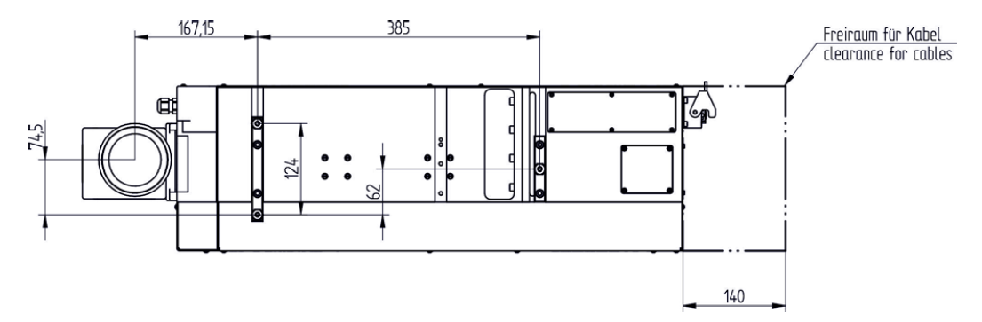
Physical Dimensions

Slide 11
THANK YOU FOR YOUR ATTENTION
www.coherent.com

